Slide 1

Mediator
Mohamed Yasser

Slide 2
What is Mediator ?!
Mediator is a behavioral design pattern that lets you reduce chaotic dependencies between objects.
The pattern restricts direct communications between the objects and forces them to collaborate only via a mediator object.

Slide 3
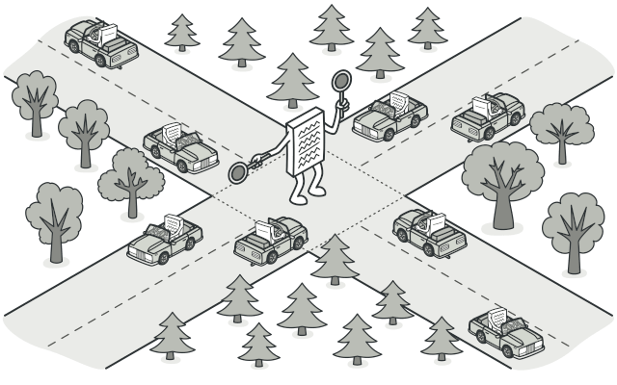

Slide 4
Problem
you have a dialog for creating and editing customer profiles. It consists of various form controls such as text fields, checkboxes, buttons, etc.
Some of the form elements may interact with others. For instance, selecting the “I have a dog” checkbox may reveal a hidden text field for entering the dog’s name. Another example is the submit button that has to validate values of all fields before saving the data.
By having this logic implemented directly inside the code of the form elements you make these elements’ classes much harder to reuse in other forms of the app. For example, you won’t be able to use that checkbox class inside another form, because it’s coupled to the dog’s text field. You can use either all the classes involved in rendering the profile form, or none at all.

Slide 5
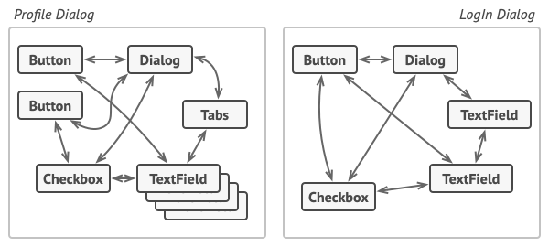

Slide 6
Solution
The Mediator pattern suggests that you should cease all direct communication between the components which you want to make independent of each other. Instead, these components must collaborate indirectly, by calling a special mediator object that redirects the calls to appropriate components.
As a result, the components depend only on a single mediator class instead of being coupled to dozens of their colleagues.
In our example with the profile editing form, the dialog class itself may act as the mediator. Most likely, the dialog class is already aware of all of its sub-elements, so you won’t even need to introduce new dependencies into this class.

Slide 7
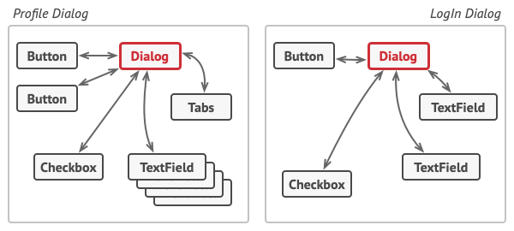

Slide 8
Real-world example
Pilots of aircraft that approach or depart the airport control area don’t communicate directly with each other.
Instead, they speak to an air traffic controller, who sits in a tall tower somewhere near the airstrip.
Without the air traffic controller, pilots would need to be aware of every plane in the vicinity of the airport, discussing landing priorities with a committee of dozens of other pilots. That would probably skyrocket the airplane crash statistics.
The tower doesn’t need to control the whole flight. It exists only to enforce constraints in the terminal area because the number of involved actors there might be overwhelming to a pilot.

Slide 9
